Slide 1
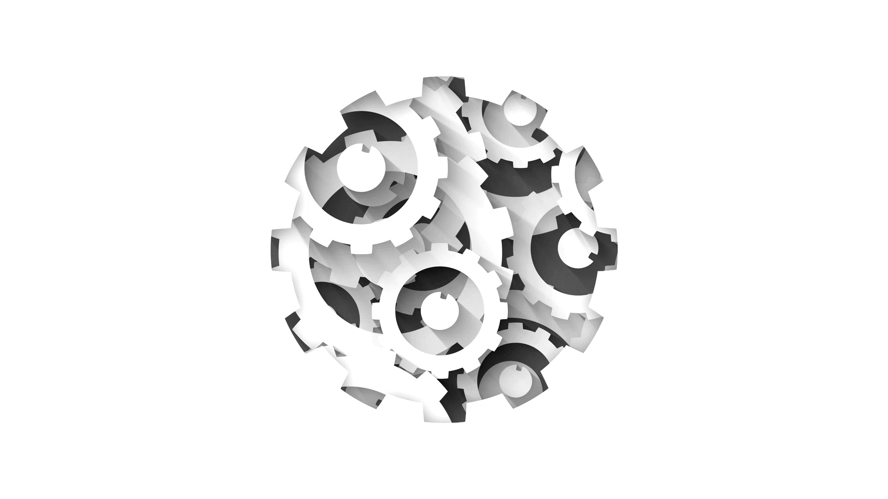


Software Engineering CS411, FALL 2025
Software Design Principles V by Dr. Mohamad Kassab
Leonidas Kontothanassis kthanasi@bu.edu

Slide 2
Objectives
Understand the steps towards creating a class diagram.
Learn how class diagrams are translated into code.
Notes:
The design model consists of interaction diagrams – which illustrate how objects collaborate to fulfill the requirements.
(design) class diagrams – summarize the definition of the software classes and interfaces that are to be implemented in software.
In practice these diagrams are done in parallel

Slide 3
Class Diagrams
Usually created in parallel to interaction diagrams following domain modeling.
Indicate:
Classes, associations and attributes
Interfaces
Methods
Attribute type
Navigability
Notes:
The design class diagram (DCD) illustrates the specification for software classes and interfaces (for example, Java Interfaces) in an application.
In contrast to conceptual classes in the domain model, design classes in the DCDs show definitions for software classes rather than real-world concepts.

Slide 4
Concepts and Classes
During analysis, domain models are created containing domain classes – abstractions of real-world concepts. Domain model is created by Requirements Engineer.
In design, the concepts are transformed into software classes which define software entities. Class diagram is created by the designer.
The final class diagram may or may not resemble the domain model.
Domain model
Design class
diagram
Notes:
A software entity is something that is going to accomplish a task.

Slide 5
How to Make a Class Diagram
1. Identify all the classes participating in the software solution by analyzing the interaction diagrams. The interaction diagrams is your starting point.
Draw them in a class diagram
2. Duplicate the attributes from the associated concepts in the domain model.
3. Add method names by analyzing interaction diagrams
4. Add type information to attributes and methods
5. Add associations necessary to support required attribute visibility
6. Add navigability to associations to indicate direction of visibility
Notes:
UP does not define an artifact called “design class diagram”
In the design model – several diagram types exist: interaction, package, classdiagrams
We will go over how to do each in the next few slides

Slide 6
Steps 1 and 2: Identify all the Classes and Attributes
Scan interaction diagrams and list classes that participate in the software solution.
Then add attributes previously noted on domain model.

Slide 7
Step 3: Add Method Names …
Messages sent to objects on interaction diagrams indicate that receiver must define a method for the call.
Note: Only indicate interesting methods (not create or accessors/mutators)
Notes:
Accessor/mutators – access and change private attributes in a class

Slide 8
… Add Method Names
Most will be indicated by the set of interaction diagrams
Notes:
The set of all message sent to a class X across all interaction diagrams indicates the majority of methods that class x must define

Slide 9
Multiobject Messages
A message to a multiobject implies a message to the container (Vector, Hashtable, etc) Not to each element in the collection.
So message to multiobject does not imply a method in each object in collection.
No find method.
Notes:
It is not useful to show these classes explicitly in the DCD since they add noise, and little new information

Slide 10
Step 4: Add Type Information
Can now add type information to attributes, method parameters and return values.
But, only if necessary!
If diagram is being created in a CASE tool with automatic code generation, full and exhaustive details are necessary.
If aimed at communicating design to developers the detail can increase noise.
Notes:
It is optional to add return values
Some reasons why to add type information:

Slide 11
Steps 5 and 6: Add Associations and Navigability
If a link exists in a collaboration diagram or a message passes between two objects in an interaction diagram, an association exists in the class diagram.
Generally viewed as attribute visibility from source to target.
Therefore, some associations in the domain model will not be indicated….in the domain model they were included to enhance understanding of the problem domain but are not justified in the software domain.
As we mentioned, the final class diagram may be different from the original domain model.

Slide 12
From Communication diagram
To Class diagram
Notes:
Navigability is a property of the role that indicates that it is possible to navigate uni-directionally across the association from objects of the source to target class. Navigability implies visibility.
Could have put currentSale: Sale to show the current Sale attribute. It was excluded because it is implied by the navigable association from Register to Sale.

Slide 13

Design to Code - The End Goal
The implementation in code is not a part of Object Oriented Analysis and Design but the end goal.
This requires code for:
Class definitions
Method definitions.
Notes:
Implementation in an object-oriented programming language requires writing source code for
Class and interface definitions
Method definitions

Slide 14
Class Definitions
We’ve seen that the attributes and method signatures of a class can be defined in detail.
It is a simple translation from these definitions into code.
public class SalesLineItem
{
public SalesLineItem(ProductSpecification spec, int qty) {…}
public Quantity subtotal() {….}
private int quantity;
}
Notes:
Shows mapping to the basic attribute definitions and method signatures for Java defintion of SalesLineItem
Note the addition in the source code of the Java constructor SalesLineItem(….)
Its derived from the create (spec, qty) message sent to a saleslineitem in the enteritem interaction diagram (slide 8).
Its usually excluded from the class diagram because of its commonality and multiple interpretations.

Slide 15
Reference Attributes
Attribute that refers to another object.
Implied by associations and navigability in the class diagram.
Role names at association-ends can be used for reference attribute names.
public class SalesLineItem
{
…
private int quantity;
private ProductSpecification prodSpec;
}
Notes:
Not another primitive type such as a String, Number, and so on.
For example, saleslineitem has an association to a productspecification with navigability to it.

Slide 16
Method Definitions
Not only can class definitions be derived from UML models, but some method structures can be extracted from interaction diagrams.
Notes:
Creating methods from interaction diagrams – shown is the enteritem interaction diagram
Interaction diagram shows the message that are sent in response to a method invocation. The sequence of these messages translates to a series of statements in the method definition

Slide 17
POST.enterItem
Since POST receives message enterItem, it must have the enterItem method defined:
public void enterItem( int upc, int qty)
Then, by considering the messages originating from the POST instance the method structure can be determined.
Message 1 if (isNewSale()){ sale = new sale();}
Message 2 ProductSpecification spec = prodCatalog.specification(upc);
Message 3 sale.makeLineItem(spec, qty);
Notes:
Message 2: a specification message is sent to productcatalog to retrieve a productspecification
Message 3: makelineitem message is sent to the sale
Each sequenced message within a method as shown on the interaction diagram is mapped to a statement in the Java method.

Slide 18
enterItem Method
public void enterItem(int upc, int qty)
{
if ( isNewSale() ) { sale = new Sale; }
ProductSpecification spec =
prodCatalog.specification(upc);
sale.makeLineItem(spec, qty);
}
private boolean isNewSale()
{
return (sale == null) || (sale.isComplete));
}

Slide 19
Updating Class Definitions
Any new methods or attributes discovered during coding must be added to the UML models to maintain consistency.
public class POST
{
public POST(ProductCatalog pc);
public void endSale();
public void enterItem(int upc, int qty);
public void makePayment(float cashTendered);
private boolean isNewSale();
private ProductCatalog prodCatalog;
private Sale sale;
}
Notes:
Important: New sale with return type of Boolean was added.

Slide 20
Implementing Multiobjects
The presence of container/ collection classes is implied in the UML by the stack symbol in communication diagrams and multiplicity values in class diagrams.
public class Sale
{
...
private Vector lineItems;
}
public void makeLineItem(ProductSpecification spec, int qty)
{
lineItems.addElement( new SalesLineItem(spec, qty) );
}
Notes:
A sale must maintain visibility to a group of SalesLineItem instances
Using a Vector the sale class can define an attribute that maintains an ordered list of SalesLineItem instances.

Slide 21


Readings , Assignments, Project Tasks
Read:
Chapters 9, 11, 12, 14 of the textbook.
Assignments & Project Tasks:
Assignment 2 is open. Deadline next Friday. This is an individual submission.

Slide 22
Git Tutorial Next Week
Prepare for the the Tutorial by installing Gitit
https://github.com/jlord/git-it-electron/releases

Slide 23

Questions?

